Slide 1
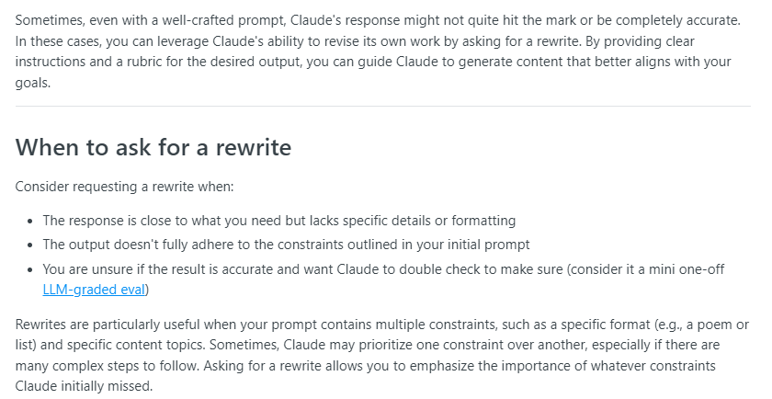
Ask for rewrites
Notes:
https://docs.anthropic.com/claude/docs/ask-claude-for-rewrites

Slide 2
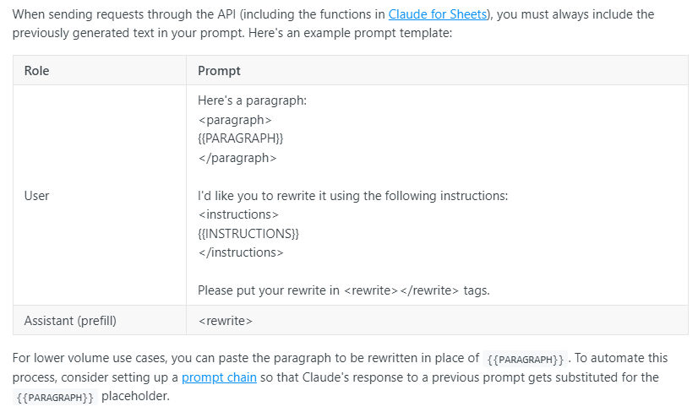
Rewrites: How to request a rewrite

Slide 3
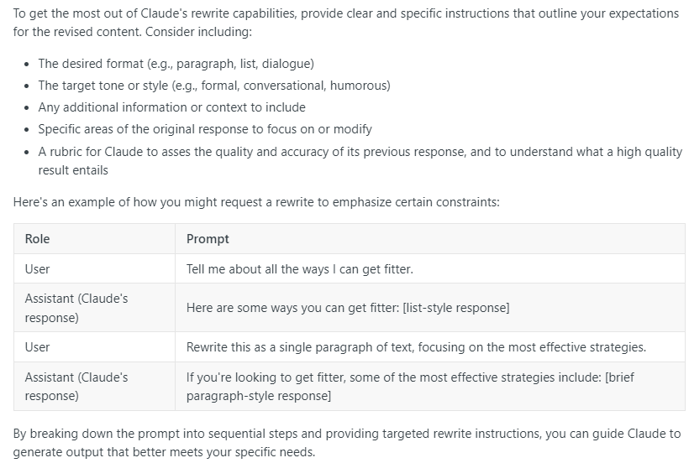
Rewrites: Crafting good rewrite instructions

Slide 4
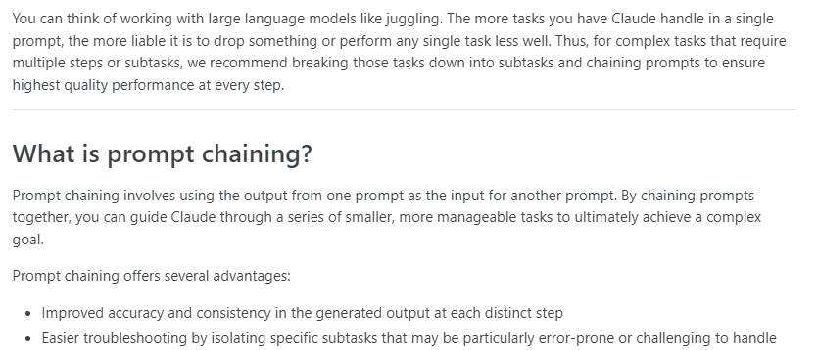
Chain prompts
Notes:
https://docs.anthropic.com/claude/docs/chain-prompts

Slide 5
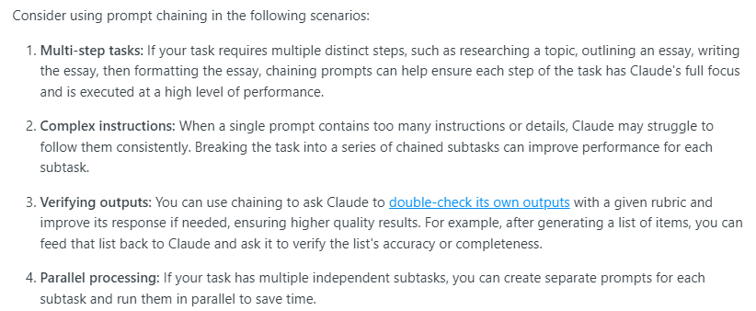
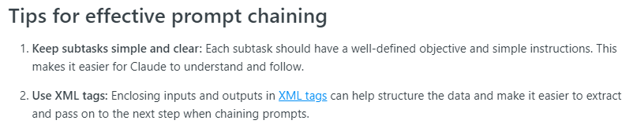
Chain Prompts: When to chain prompts

Slide 6
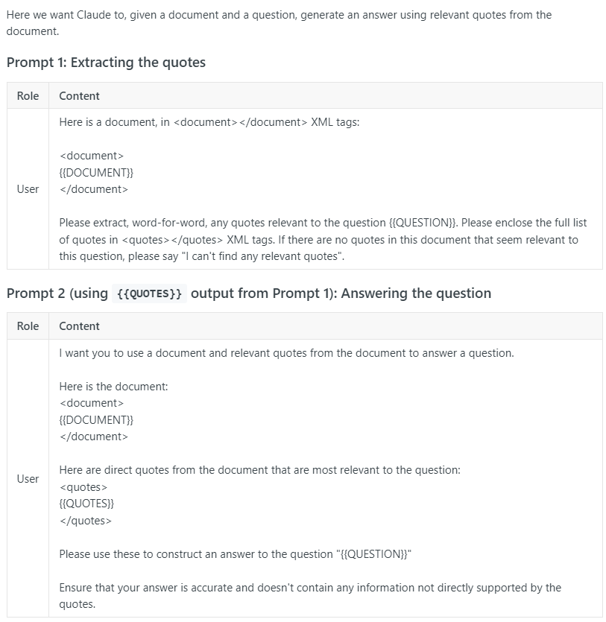
Chaining Prompts: Answering Questions

Slide 7
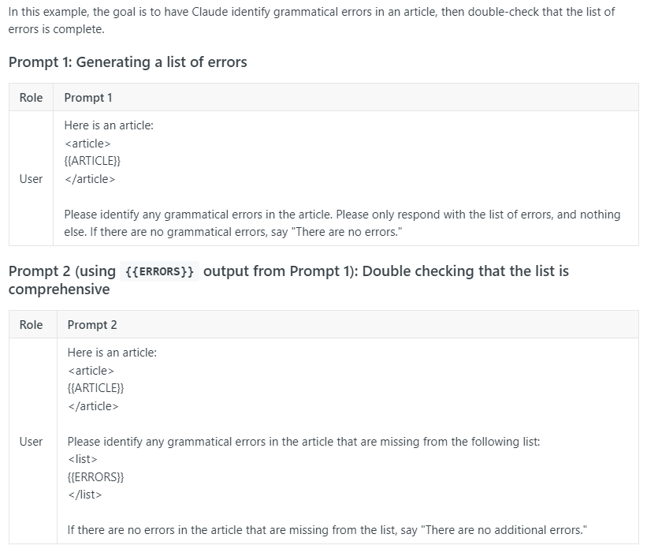
Chaining Prompts: Validating Output

Slide 8
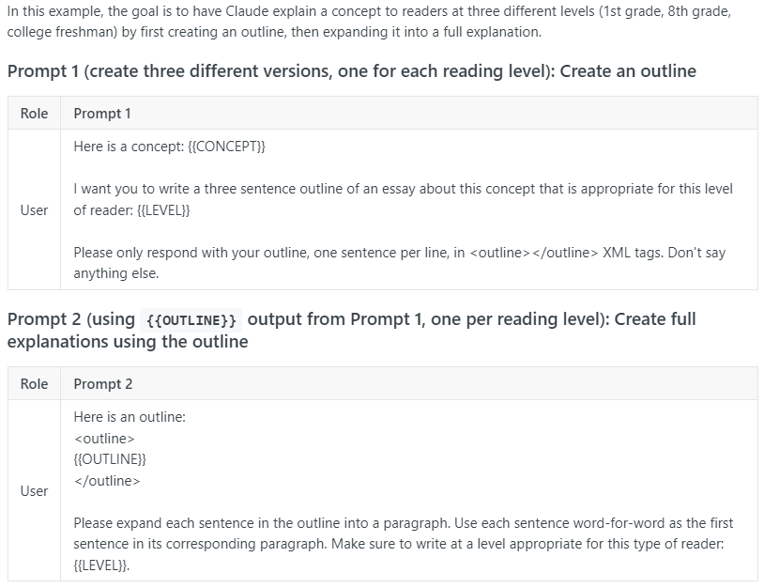
Chaining Prompts: Parallel Processing

Slide 9
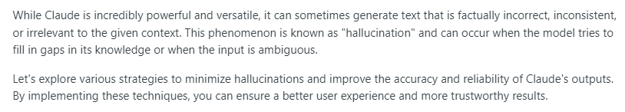
Minimizing Hallucinations
Notes:
https://docs.anthropic.com/claude/docs/minimizing-hallucinations

Slide 10
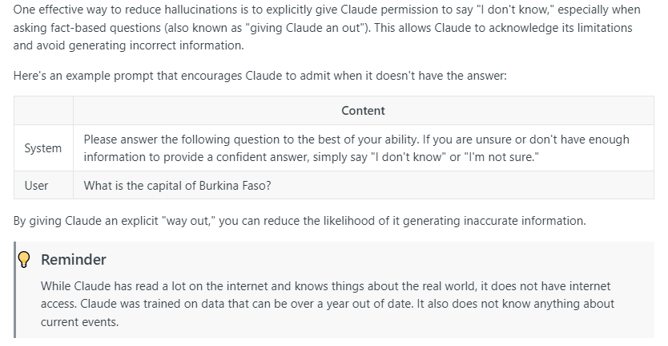
Minimizing Hallucinations: “I Don’t Know”

Slide 11
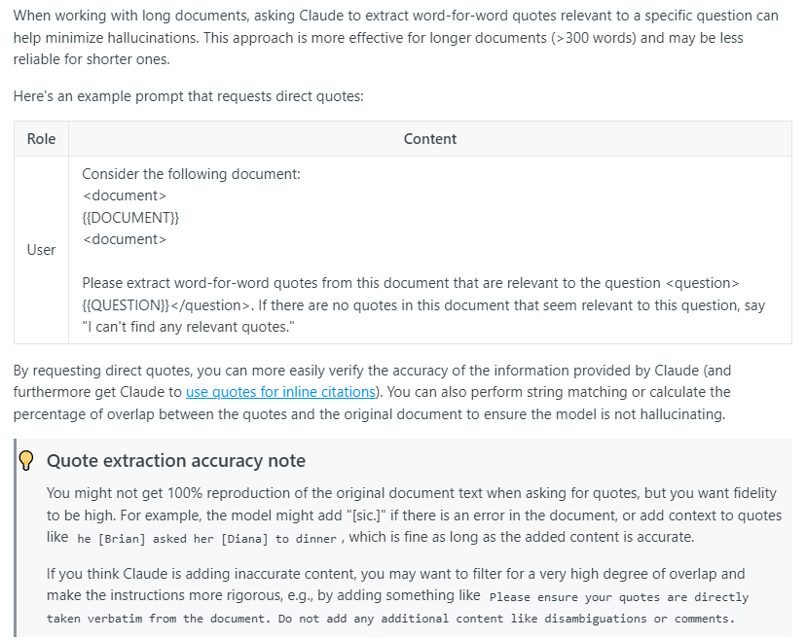
Minimizing Hallucinations: Ask for direct quotes

Slide 12
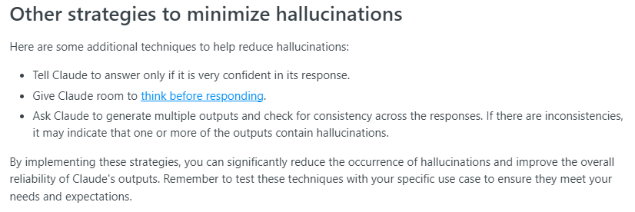
Minimizing Hallucinations: Other Strategies

Slide 13
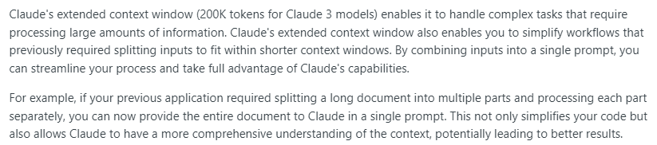
Take advantage of long context window
Notes:
https://docs.anthropic.com/claude/docs/long-context-window-tips

Slide 14
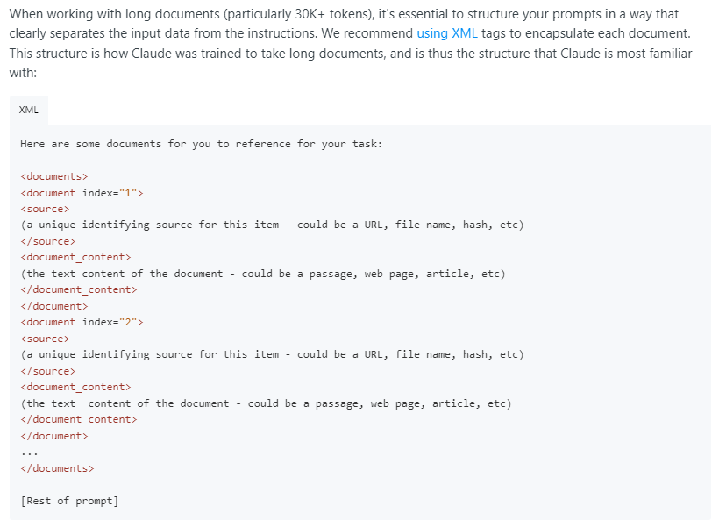
Long context window: Structuring long inputs

Slide 15
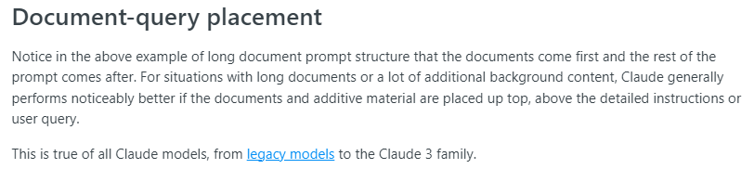
Long context window: query placement

Slide 16
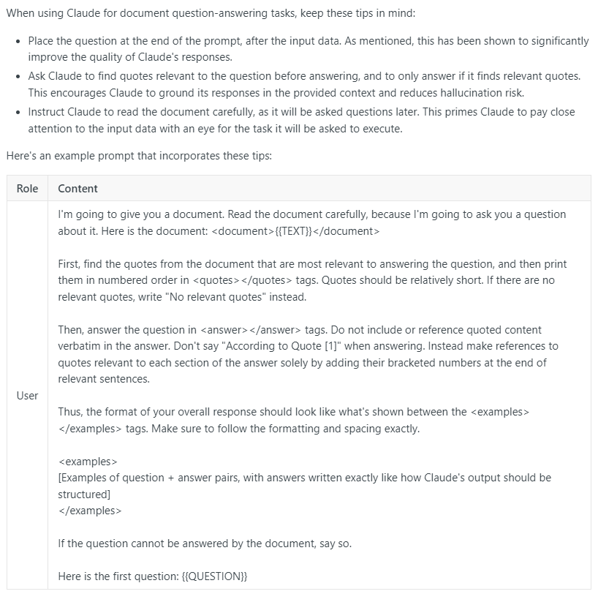
Long context window: Document Q&A

Slide 17
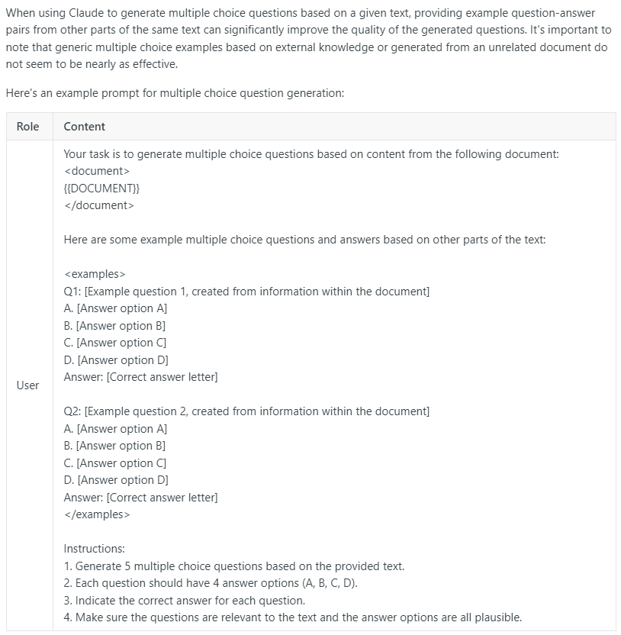
Long context window: Multiple choice question generation

